Slide 1
Your Member and Family Assistance Program
Orientation
Presenter: Barb Walsh
Homewood Health
Notes:
MANDATORY

Slide 2
Agenda
About Homewood Health™
Your MFAP
  Counselling
  Life Smart Coaching
  Homeweb.ca
Confidentiality
Accessing the MFAP
Notes:
MANDATORY

Slide 3

Who are we?
Homewood is a trusted Canadian company; providing MFAP services to clients like you since 1979.
Homewood is Canada's leader in mental health and addiction treatment and is supported by a national network of over 4500 employees/members and clinical experts.
Homewood's MFAP services are delivered by qualified professionals including registered coaches and certified counsellors.
Notes:
MANDATORY

Slide 4
When do you call your MFAP?
Notes:
OPTIONAL – time permitting

Slide 5

Your MFAP can help with:
A wide variety of situations:
Stress, anxiety, depression
Life change and transitions
Relationship concerns
Family and parenting challenges
Child care coaching and resources
Elder care coaching and resources
Grief or bereavement
Alcohol, drug, gambling, smoking issues
Legal concerns
Financial worries
Medical or health-related information
Career development
Healthy lifestyle changes
Notes:
OPTIONAL – time permitting

Slide 6
Full Suite of MFAP Services
Counselling
  Face-to-face
  Telephonic
  Video
  Online
  (email or chat formats)
Life Smart Coaching
Life Balance Solutions
Health Smart Coaching
Career Smart Coaching
Online Resources
  Homeweb.ca
  Online Courses
  Child and Elder Care Locators
  Health Risk Assessment
Notes:
MANDATORY

Slide 7

MFAP Highlights
Accessible toll-free 24 hours a day, 7 days a week, 365 days a year
In person, telephone, video, online (self-register at homeweb.ca)
Book an appointment or access help right away, including crisis support
Multi-cultural and multi-lingual
For members, spouse/partner, eligible dependents
Participation is voluntary
Private and confidential
No cost to the user
Notes:
MANDATORY

Slide 8
Life Smart Coaching
Notes:
MANDATORY

Slide 9
Life Smart Coaching
Practical and proactive resources that help people ‘Life Smart’
Telephonic assessment of needs by a specialist.
Information and supportive coaching from an expert in the field.
Customized searches for relevant resources.
Up-to-date and tailored information including:
  topical workbooks
  current articles
  referral to online tools and resources
Notes:
MANDATORY
9

Slide 10
Life Balance Solutions
Notes:
MANDATORY

Slide 11
New Parent Support
Coaching and information on what to expect and how to succeed as a new parent.
Expert information/advice from
a parenting specialist
Package of information tailored
for specific needs
Post-delivery support
Notes:
MANDATORY
11

Slide 12

Childcare and Parenting and Parenting
Support for parents who face parenting or family challenges.
Consultation with a childcare specialist
Customized resources to match the need:
  Child or daycare facilities
  Adoption services
  Special needs/gifted
  Summer camps
  and much more…
Personalized package with resource information, as needed
Notes:
MANDATORY
12

Slide 13
Elder and Family Care
Support for people caring for aging parents or loved ones.
Consultation with a elder care specialist
Customized resources to match the need:
  Support options
  Long-term care facilities
  Seniors’ residences
  Mobility tools
  and much more…
Personalized package with resource information, as needed
Notes:
MANDATORY

Slide 14

Financial Consultation
Helping people enjoy financial peace of mind.
One-on-one consultation with a financial expert
Guidance for a broad range of issues including:
  Financial goal setting
  Budgeting
  Getting out of debt
  Establishing or rebuilding credit
  Financial challenges resulting from separation/divorce, disability, income loss
  Estate and retirement planning
Notes:
MANDATORY

Slide 15

Legal Advisory
Providing consultation and clarification on legal matters.
One-on-one advice/consultation with a lawyer
Guidance on a broad range of issues including:
  Family law
  Civil litigation
  Real estate
  Wills and estates
  Criminal
  Immigration law
Lawyer referrals available
Notes:
MANDATORY

Slide 16
Relationship Solutions
Support for people looking to revitalize their relationship connection.
Self-directed resource
Ideal for couples looking to:
  Reignite the flame
  Improve communication
  Positively deal with conflict
  Grow together as a couple
  Prepare for cohabitation
Notes:
MANDATORY

Slide 17
Grief and Loss
Grieving can be an overwhelming and complex process.
Self-directed resource
Ideal for individuals looking for help with:
  Recently losing a loved one
  Divorce or relationship loss
  Job loss
  Child grief
  Emotional support

Slide 18
Stress Solutions
Focuses on the cognitive aspects of stress, and connections between thoughts and feelings. Sessions will encompass stress management, lifestyle, priority management and tools such as meditation and relaxation techniques
Expert information/advice from a qualified coach/stress specialist
Addresses the nature of the concerns raised directing the client to the most appropriate and best-suited service to support the presenting issue(s) or concern(s)
Includes a letter of resources and a welcome document, providing an overview of stress issues and stress management techniques
Notes:
MANDATORY

Slide 19
Health Smart Coaching
Notes:
MANDATORY

Slide 20

Nutritional Coaching
Helps to improve eating habits and understand how nutrition can positively impact some illnesses.
  Registered Dietitians provide:
    initial assessment
    step-by-step action plan
    ‘how to’ advice and coaching
  Helpful for weight management, eating for energy, disease state management
Notes:
MANDATORY

Slide 21

Jumpstart your Wellness
Support for people looking to achieve specific health and wellness goals.
Participants receive access to a range of online tools and resources including:
  A Readiness for Change questionnaire
  Articles
Includes coaching with a behaviour-change
consultant with expertise in the ‘goal’ area
Develop new behaviours to create positive and lasting lifestyle, productivity and work life changes
Notes:
MANDATORY

Slide 22

Smoking Cessation
Support for quitting one of the most difficult addictions.
Helps to address:
  physical dependence
  psychological dependence
  foundations of successful
  behaviour change
Specialists provide coaching incorporating the latest, proven behaviour-change techniques
We help direct you to a comprehensive program of your choice
Notes:
MANDATORY

Slide 23
Career Smart Coaching
Notes:
MANDATORY

Slide 24

Career Coaching
Assists people in identifying and articulating skills, aptitudes, values, personality traits, and interests related to their career.
Depending on individual need, coaching is provided related to career areas, including:
  Problem solving and conflict resolution
  Change and transition management
  Time management
  Stress management and work-life balance
  Building cooperation with co-workers
Notes:
MANDATORY

Slide 25

Shift Worker Support
Assists in making shift work easier and shift workers healthier.
Specialists conduct a full assessment of areas typically affected by working shifts, such as sleep, nutrition
and diet, social challenges,
home environment, etc.
Coaching, tips, online, and
other resources are provided
depending on the needs
highlighted in the assessment.
Notes:
MANDATORY

Slide 26
Counselling Services
Notes:
MANDATORY

Slide 27

About Counselling
Short-term, solution-focused counselling — a client-centred approach to goal setting and problem solving
Bridging to community services, specialized referrals and treatment,
if needed
Professional standards include a minimum of Masters degree
Multilingual, diverse clinical network; counsellors are experts across many areas
Access to elder/traditional healer/knowledge keeper/cultural advisor/spiritual leader , if preferred.
Notes:
MANDATORY

Slide 28
Online Services
Notes:
MANDATORY

Slide 29

Homeweb.ca
Online Service Locators
Locators for both child and elder
care services
Health & Wellness Resources
Comprehensive suite of online tools to assess
health risk and develop improvement plans
Health Risk Assessment (HRA) tool
Health Library
Online Courses
Empowers learners to better manage
personal health and expand work-related skill sets
Notes:
MANDATORY

Slide 30


Child & Elder Care Locators
LifeStage
for Children & Teens
LifeStage
for Seniors
Immediate access to the most complete, impartial, and current information on personal and family care providers in Canada.
Notes:
OPTIONAL – time permitting (already mentioned on previous slide).

Slide 31
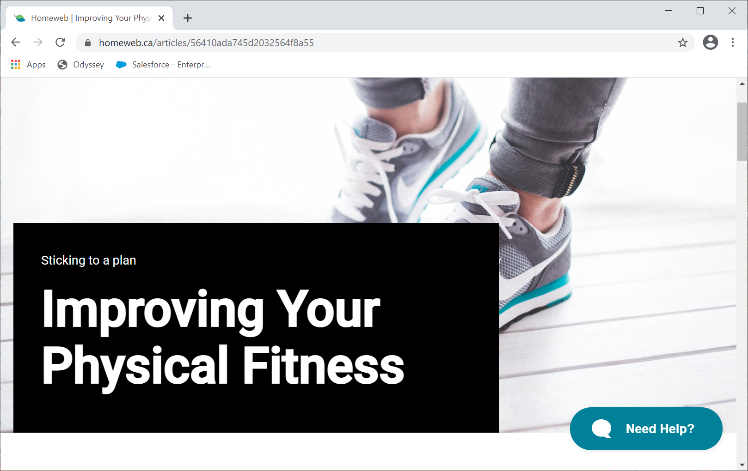
Health & Wellness Library
articles and resources by qualified subject experts
information on drugs, disease, natural products,
tests, procedures, and general health
exclusively Canadian content
Coaching, tips, online, and other resources
are provided depending on needs

Slide 32
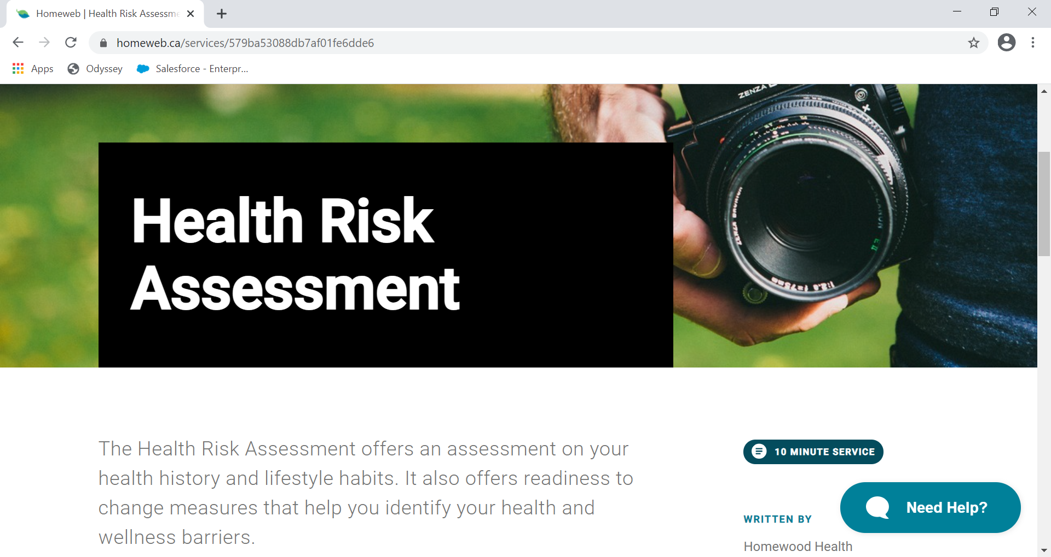
Health Risk Assessment
Extensive nutritional assessment tools, and overall readiness to change measures
Assesses four specific dimensions of emotional health: work-life balance, anxiety, depression, and stress

Slide 33



Online Courses
For Members & Family:
Taking Control of Stress
Taking Control of Anger
Resilience
Taking Control of Your Mood
Foundations of Effective Parenting
Taking Control of Job Loss and Transition
Resolving Conflict in Intimate Relationships
Embracing Workplace Change
Responsible Optimism
Taking Control of Alcohol Use
Taking Control of Your Career
Taking Control of Your Money
Stop Smoking: Get Your Life Back
Preparing For Your Retirement
Respect in the Workplace
For People Leaders:
Leading the Human Side of Change
Values-Based Leadership
Managing Sensitive Member Issues
Supporting Respect in the Workplace
Fundamentals of Effective Supervision
Notes:
OPTIONAL

Slide 34

i-Volve - Online CBT
i-Volve Online CBT for the treatment of depression, anxiety, and other mental health disorders.
24 self-guided, evidence based and clinically validated modules available on desktop or mobile devices
Teaches coping strategies based on individual’s challenges and experiences
Empowers and enables individual to challenge their disorder while modifying their lifestyle
Provides an alternative online solution versus traditional face to face and telephonic therapy
Accessibility, removes barriers and limitations for those seeking treatment
Convenient, at your own pace, available 24 hours a day, seven days a week
no scheduling required with no geographic or location restrictions
Anonymity, encourages openness and self-awareness, increasing self-honesty and empowers individual to pursue success

Slide 35

Life Lines Newsletters
Accessed at homeweb.ca and Homewood Health’s free APP: e-AP
Also available as short videos and podcasts

Slide 36
Privacy and Confidentiality
Our Commitment
Information is confidential
Appointments scheduled for privacy
Private offices are offsite
Clients contact us directly
Phone messages are never left without prior permission
Flexible scheduling
Reports include group data only
Secure record-keeping
No identifying information is transferred to anyone without your known, written consent.
Exceptions are
children at risk,
risk to self or others,
or subpoena.
Notes:
MANDATORY

Slide 37
Information Collected
Our questions are brief and respect confidentiality and privacy.
Name, address, organization, job
to determine eligibility and benefit coverage
Immediacy of need
Relationship to member
if a dependent or family member
General nature of issue
to direct to appropriate counsellor or service
Appointment time/location
Notes:
MANDATORY

Slide 38
Accessing Your MFAP is easy
Notes:
OPTIONAL – time permitting

Slide 39
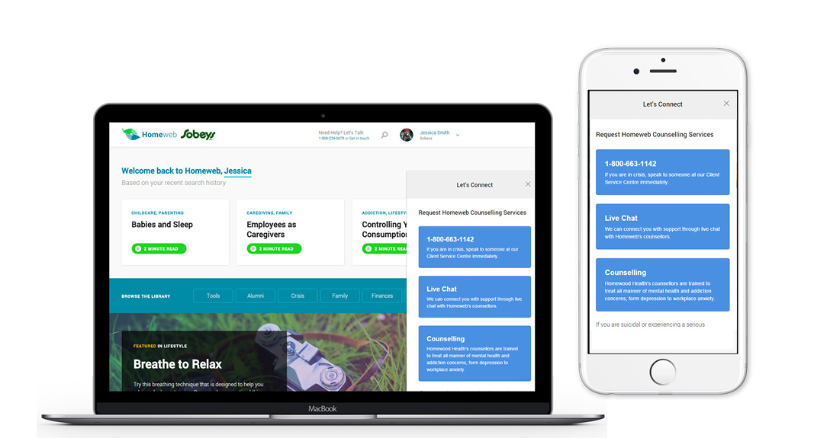

Homewood Health APP – E-AP
Supporting you and your family members.
Fast and easy access to counselling, live chat and on-line services.
Homewood Health’s APP (e-AP) is free to download and is available in the Apple Store and Google Play (Android).

Slide 40



Homewood Pathfinder at Homeweb.ca

Slide 41
Homewood Pathfinder MFAP: Homeweb.ca
Homewood PulseCheck
A simple slider when users visit that presents appropriate resources and looks at wellness over time
Pathfinder Journeys
Clinical assessments and future
forward technology offer up the
right service at the right time
MeetNow & Online Booking
Book a professional seamlessly, or when
available, speak with one right away.
My Dashboard
Personalized jumping off point for guided journeys, resources, PulseCheck recommendations and counselling

Slide 42

Connect to your MFAP
1-800-663-1142 (English)
1-866-398-9505 (French)
1-888-384-1152 (TTY/hearing impaired)
604-689-1717 International (call collect)
homeweb.ca
Notes:
MANDATORY

