Slide 1
Webinar on Openness in Adoption #5 The Work Begins: Implementing the Openness Plan
Welcome to Today’s Webinar!
If you haven’t yet dialed in for the audio, please dial in to the teleconference at :
1-888-407-4369 Participant Pin 96938721#
Your phone line will be muted upon entry. It is normal not to hear anything until the webinar begins.
Please use the chat box in the bottom right corner to type your questions.
Also, please Mute your phone.
If you do not have a Mute button, press *1
AND ... Please mute the sound on your computer!

Slide 2
Implementing the Openness plan
Karen Milne – Family Visitation Program
Tara Cunningham – Adoption Services
Children’s Aid Society of Ottawa
Notes:
Karen if you can introduce yourself and speak to how you started doing the work around transitions etc….

Slide 3
Preparation work with caregivers
Through Family Visitation, prep work can be completed with birth parents, children, extended birth family members and foster parents
Opportunities for transition to openness, grief work and empowering families through inclusiveness
Notes:
Set the stage here that this is typically post Crown Wardship order
Communication with all workers involved is key
Moving from access to openness

Slide 4
Tools for worker
Be aware of language
Include family in planning
Stay away from terms such as: “goodbye visit”, “last visit”, “supervised access”
Introduce terms such as: “goodbye series”, “transition series”, “birth parent”, “adoption”, “permanent families”, “openness” etc..
Timeline planning
Include family in the “how: ie- activities they wish to do with the children, arrange for visits outside offices, include picture taking , complete a picture/story book with parents and children
Notes:
Provide real examples of activities that you have done, how you have gone about taking pictures, collecting historical pictures to help create a picture/story book, how you included family members in this activity.

Slide 5
Tools continued…
Be flexible
Adapt timeline and activities based on age of child and level of functioning of the parent, parent’s emotional readiness
Use visual supports such as calendars and pictures can be useful
Have foster parents involved to help prep, do transportation and de-brief
Ensure you reserve time after the activity to possibly drive the parent in order to de-brief, support or simply spend time with them
Notes:
Provide real examples of activities that you have done, how you have gone about taking pictures, collecting historical pictures to help create a picture/story book, how you included family members in this activity.

Slide 6
Preparing Children for Openness
Children need to understand that their relationship with their birth parents is changing
Openness is not a continuation of access
Children need to grieve this loss

Slide 7
Tools
Life books
Mobility Mapping Tool – Kevin Campbell / Family Finding model
Signs of Safety Tools
Three Houses
Words and Pictures

Slide 8
Three Houses Tool

Slide 9
Words and Pictures
Use of drawings / photos / etc.
Modify to use lifebook photos to tell the story
Introduces the changing relationship in openness
Give a common narrative for child, foster parent, birth parent and future adoptive parent

Slide 10
Adam was born on September 1, 2010.
He weighed 6 pounds 5 ounces.
Adam was a beautiful baby with blue eyes and brown hair.
He lived at home with Mommy M. Mommy M. Loved Adam.

Slide 11
.
Sometimes Mommy M. drank too much alcohol and she couldn’t wake up to take care of baby Adam.
Sometimes she didn’t feed him on time or change his dirty diaper.
That made Adam sad and scared.
Adam was a baby and needed a grown-up to take care of him.

Slide 12
Adam visited with Mommy M. and they had fun. Visiting is different than being a Mommy everyday. Mommy M. needed to stop drinking alcohol so that she could take care of Adam and keep him safe. Mommy M. loves Adam very much. She tried very hard, but she could not stop drinking alcohol.

Slide 14
Tools (cont)
3-5-7 Activities (Darla Henry)
Tools to Engage child in activities through play, art, etc. to explore feelings about the events and relationships in their lives.
Supports grief work and understanding of past and future relationships.
http://darlahenry.org

Slide 15
String activity (connections)

Slide 16
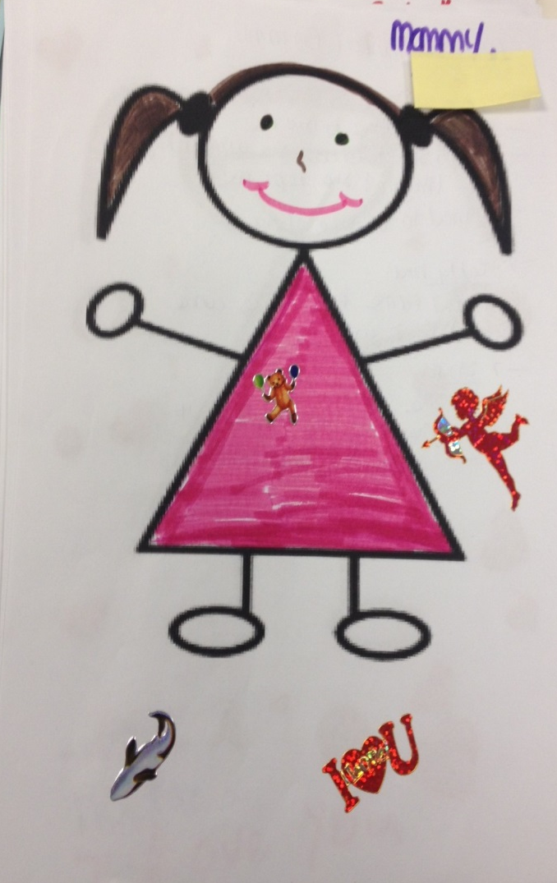
Family Relationships

Slide 17
PREPARING Adoptive Parents
Preservice training
Education / Discussion throughout homestudy
Assessment of specific areas of strength or vulnerability in openness relationships (eg experience with and views of addiction)
Avoid discussions of type of contact, frequency of contact, but focus on philosophy of openness and value for child through life span
Real life examples from adoptive parents are imperative

Slide 18
Matching and Disclosure
Sharing of information in disclosure – why is openness important and beneficial in this child’s situation
Balance to information being shared
Use of activities done with child may bring significance of relationships to life

Slide 19
Building relationships
Early meeting with birth family member where there will be openness
Support needed by adoption worker (separate from birth parent counsellor)
Use of lifebook and other child activities in the preplacement and visiting phase

Slide 20
Placement ceremonies
E.g. candlelighting ceremony
Acknowledges the birth family connections for the child tangibly
Reinforces the strength and value of the connections even for a child who is younger and does not understand the ceremony.
Cultural connections can also be reinforced through these ceremonies – eg. Smudge with elder

Slide 21
The goal
Birth family members are respected for the strengths that they bring.
Birth family members have supports to assist them with their grieving.
Birth Family Members are better prepared to move into a different role with the child and to build relationships with adoptive parents

Slide 22
The goal
Children’s feelings about the people in their lives are valued and respected as they move on to adoption.
Children have an understanding of their story and the changing relationships in their lives.
Supports attachment in the new adoptive family

Slide 24
The goal
Adoptive parents will embrace the philosophy, not just agree to a certain “schedule”.
This will support tolerance for the challenges that will arise and creativity in managing openness relationships as the child grows and family situation evolves.

Slide 25
Different Paths to Openness

