Slide 1
Working with clinicians on openness files
Tara Noble

Slide 2
We all have the same goal…
Permanency for Children
Provide child with attuned, sensitive caregiving
Allow children to develop in a healthy & adaptive way
Avoid future relationship ruptures/trauma/adoption breakdown

Slide 3
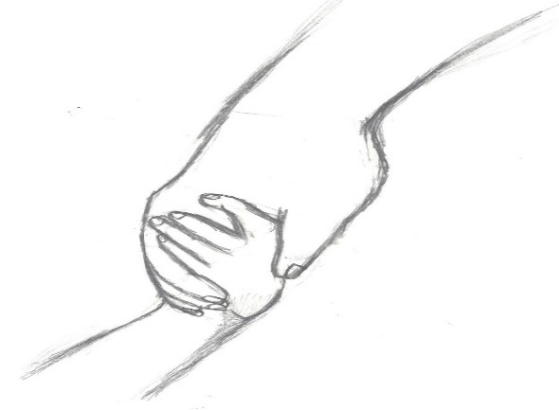
Let’s not re-invent the wheel
We can utilize our understanding of:
Attachment Theory
Theories of Grief and Loss
Caregiving, interventions and support that promote positive outcomes for children
Establish a child’s sense of belonging & strong identity

Slide 4
Attachment
Secure attachment
Insecure attachments
Despite trauma, abuse, neglect that cause insecure attachment- Children are remain attached.
Repair occurs through attuned caregiving understanding a child’s needs and experiences, accompanied by an accurate life story.

Slide 5
Theories of grief & loss
Bowlby: through attachment lens-stages include
Numbing-Yearning &Searching- Disorganization-Reorganization
Kobler-Ross: grief cycle
Used widely now to conceptualize grief has different components but is not a linear process
Most Theories suggest grief is complete at the point when a person is “detached” or “resolved” or “moved on”
Klass, Silverman, Nickman: Continuing Bonds
The idea when a person can continue to have a relationship with the deceased, however it changes, becomes redefined and continues over one’s lifetime

Slide 6
So let’s consider
Children often continue to stay connected to their roots/significant caregivers even after death- BUT in adoption the “roots” are still tangible
When can we avoid further loss for a child through open adoption?
How can we support biological families and adoptive families differently?
How can we best create an accurate life story over time?
How can we avoid children creating fantasies about their bio families?
There is great danger is creating and “us” and “them”
The power of social media

Slide 7
Acknowledgement
Not all adoptions can be open
i.e significant safety concerns
BUT….
What if it was our starting point

Slide 8
Benefits to openness
Child maintains sense of connection “roots”
Access to cultural identity, medical, genetic make up
Develop life story, the reason for placement and adoption. This can evolve over one’s life time in a supported way.
Child has “real” experiences of their birth family (strengths and flaws) vs idealization through the unknown.
“A Village” to raise them…..
There is no reason for a child to search
Relationship with adoptive parents vs biological is not viewed as competitive, but rather supportive and child focused

Slide 9
Transparency is Key
Adoptive Parents need:
An accurate picture of the child
Support to facilitate discussions about adoption
Support to accept a child’s roots and curiosities
Support to continue to address questions and concerns as they arise
An understanding of their role in supporting bio relationships
Biological Family needs:
Support to grieve the change in role
Clear openness arrangements/expectations
Guidance to support the adoption, and facilitate a healthy connection to the child.
Both would benefit from a process of demystifying each other & contributing to the child’s life in a child focused manner.

Slide 10
Resources Required
Counselling for adoptive parents regarding the inclusion of caregivers. Facilitate understanding of the benefits to openness while addressing fears/challenges.
Counselling for biological parents/family to facilitate grieving, lay out what is expected of them to have openness, to accept new role and to support child’s connections to the new family.
Understand each persons perspective on what “openness” is and ensure a clear plan. This may need adjustments as the child develops or circumstances change.
Let’s put the responsibility on the adults to do the work needed to ensure children do not suffer unnecessary grief and loss.

