Slide 1
Adoption Webinar:
Openness in Adoption #3 - Bringing the Child's Voice to Openness Planning - Working with the Office of the Children's Lawyer
Welcome to Today’s Webinar!
If you haven’t yet dialed in for the audio, please dial in to the teleconference at :
1-888-407-4369
Participant Pin 96938721#
The phone lines are muted. It is normal not to hear any audio until the webinar has started.
The webinar will be recorded and made available on the OACAS Members’ website.
If you are hearing an echo, please mute the sound on your computer!
Notes:
Mary B (or Ene)

Slide 2
The involvement of the OCL in access, openness and adoption
Elizabeth McCarty
October 15, 2015

Slide 3
OCL as child’s counsel
The OCL is the legal representative for the child
We have a solicitor/client relationship
We are advocates for our client’s views and preferences where they can be ascertained

Slide 4
Child Protection applications

Slide 5
oCL Involvement in child protection Applications
Appointed in child protection proceedings to represent children pursuant to s. 38 of the Child and Family Services Act
Take a variety of positions in the proceedings on issues before the court including disposition, access, terms of supervision and/or access, etc.
We meet with our clients, speak to the CAS staff, meet with parents and various collaterals on the file
Take a position based on the client’s views and preferences - including obtaining access orders to maintain relationships that are important to our clients
Notes:
Discuss the changes in the case law re impair adoption and beneficial and meaningful and that we will be calling evidence to meet these tests

Slide 6
openness

Slide 7
OCL Involvement in Openness
Four Mechanisms to Involve OCL
  Ministry of Children and Youth Services Protocol
  Court order under s. 153.5
  Child Protection ADR
  Re-open a Previous OCL file

Slide 8
Who gets served and with what?
Access Holders (person who has been granted an access order)
Access Recipients (person with respect to whom an access order has been granted)
If the access holder is an adult – served with a Form 8D.2
If the access holder is a child – served with a Form 8D.3
See rule 34(17)(e) and (f) of FLR and s. 145.1.1(2) and (3) of the CFSA
The access recipient is served with a Form 8D.4 whether they are an adult or a child
See rule 34(17)(g) of the FLR and s. 145.1.1(2) and (3) of the CFSA
Notes:
Before discussing the 4 different ways to get the OCL involved – IMPORTANT TO REVIEW WHAT IS AN ACCESS HOLDRER /RECIPIENT – they are terms that I will be using throughout

Slide 9
MCYS Protocol
If the child is an access holder, you have to serve the OCL on the same business day as the child is served (this does not replace service on the child)
You must provide the OCL with the following:
  A copy of the notice served on the child
  A copy of the access order and any other child protection order that is currently in force with respect to the child
  A copy of the “Notice to the Office of the Children’s Lawyer that a Child is Being Served with Form 8D.2 or 8D.3”
If the child is an access recipient –there is presently no requirement to serve the OCL
Notes:
Despite what many people think, we did not develop this protocol. It was developed from concerns as to what a 8 year old child would do when they receive a piece of paper that says their access will be terminated and they can bring an openness application

Slide 10
Appointment under s. 153.5
OCL can be appointed in another person’s Application for openness by order of the Court
Appointment is made under s. 153.5 of the CFSA (not section 38 and a different standard form order is used)
The consent of the OCL is required to make an order under s. 153.5
If we bring an Application for openness to a sibling who did not have a lawyer assigned, the OCL may bring a motion appointing counsel for other siblings
Notes:
Please do not make the orders under s. 38

Slide 11
ADR Referral
Anytime ADR is considered by a Society, they must notify the OCL using a form designated by MCYS
Allows the parties to develop a plan for openness prior to the notices being served
Adoptive parents are normally directly involved in the process
Plan should include what happens with the terms that are developed – ie order or agreement
Notes:
Real need for trained mediators who can view the mediator from an adoptions lens and focus on interest based models.

Slide 12
RE-Open a previous file
How?
What will we do?
Just Call!
Elizabeth McCarty – 416-314-8108
When we have previously represented a child, we will re-open a child protection file prior to notices being served
If a conflict has developed we can still re-open the file and assign more than one counsel

Slide 13
Important points about Service of Notices
You must serve the OCL directly if the child is the access holder
Providing the OCL with notice does not replace serving the child
The notice does not terminate the access – the access order is still in force and effect until placement for adoption
The OCL will require an affidavit of service to show when the limitation period begins
Service can become complicated when there are adoption plans for different children at different times

Slide 14
Important to seek legal advice
Implications of serving the incorrect notices or not serving notices can have far reaching consequences
Children’s Aid Society of the Regional Municipality of Waterloo v. KJR, DERD, DFD, and EGI, [unreported] May 26, 2015(OCJ)
Bruce Grey Child and Family Services v. RG, 2015 OJCJ 412 (CanLII)

Slide 15
What to Expect from OCL in an openness file
Steps we take:
  Meet with client
  Talk to CAS adoption workers
  Request disclosure
  Meet with adoptive parents
  Meet with other family members who are seeking openness or to whom child wants openness
  Identify any cultural issues that many need to be addressed with openness
  Bring Application for openness – only have 30 days
  Participate in ADR if appropriate
  Participate in Court related matters
Notes:
Given timelines it is not always possible to take all of these steps before issuing the Application

Slide 16
Orders vs. Agreements
Sibling access cases
Young Children vs. Older Children
Court process under CFSA for varying/terminating access v. CLRA
Flexibility can exist in an order or agreement
How open are the adoptive parents to openness
Established patterns of contact vs. new adoptive parents
Adoptive parents’ views on orders v. agreements
What are the mechanisms to protect the contact if it doesn’t happen
Our client’s views if ascertainable
Nature of protection concerns

Slide 17
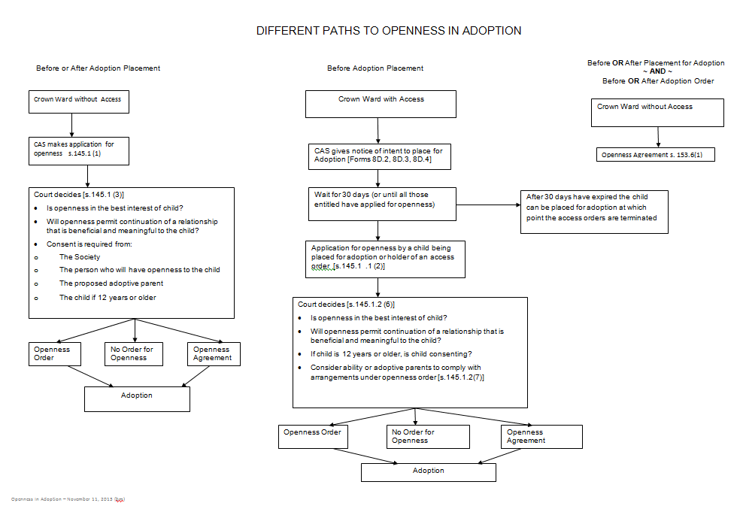
There are many paths to openness

Slide 18
What steps can we take to work together on openness files
Preparation is key – Adoptive parents, biological family and children
Good communication between the Adoption departments and the OCL counsel
Early involvement of OCL
Ongoing continuing education for all sectors
Discussion/Planning at the Crown wardship stage is essential
Minimize the procedural problems
Building in supports

Slide 19
adoptions

Slide 20
OCL Involvement in Adoptions
Under s. 137(6) and (11) the OCL provides Independent Legal Advice to:
  Children age 7 and older who are being adopted; and
  Minor parents consenting to their child’s adoption
Before meeting a child panel lawyers will require:
  a copy of the Crown wardship order
  the adoption questionnaire
  proof of residency and original identification
  copies of any openness orders and/or agreements
  a file number from the OCL

Slide 21
Adoptions continued
Each child 7 and older requires their own OCL counsel (even when they were represented by the same counsel in the past).
What if the child doesn’t have capacity to consent? What can we provide on a motion to dispense with the child’s consent?
CFSA provides that a consent shall not be given until children have had the opportunity to obtain counselling regarding the adoption.

